Slide 1
AI based Chatbot to answer FAQs
Submitted in the partial fulfillment for the award of the degree of
BACHELOR OF ENGINEERING
IN
ARTIFICIAL INTELLIGENCE AND MACHINE LEARNING
Submitted by:
Avanish Rai – 20BCS8812
Priyanshu Singh – 20BCS6896
Under the Supervision of:
MRs. Anita
Department of AIT-CSE
DISCOVER . LEARN . EMPOWER

Slide 2
Outline
Introduction to Project
Problem Formulation
Objectives of the work
Methodology used
Results and Outputs
Conclusion
Future Scope
References

Slide 3
Introduction to Project
The implementation of artificial intelligent systems has been implicated by the advancement of information technology and communication. The systems are nearing excellence. Human interfaced decision support systems, robotics, and artificial intelligence expert systems, natural language processing, and many more.
Even in the case of there are some hybrid methods in artificial intelligence fields as well as adaptable methods that make more complex way. Furthermore, there are hybrid natural languages and co adaptable systems that can understand human natural language.
These interfaced systems is able to educate themselves and enrich their knowledge by reading all electronics articles available on the internet. As a end-user, client can ask questions to the system in the same way that could be done with another human.
These systems commonly named as intelligent answering machines. Added on to intellectual answering-engines, the internet in recent times has numerous applications of chatter-boot, also termed as chatbot, which are developed for designated purposes or simply entertainment.

Slide 4
The so called application work is much easier, as the knowledge has already been educated. The virtual assistant would suit the speaker's or user's input sentence with an algorithm that appeared on the knowledgebase.
Also every pattern is associated with chatbot knowledge gained from multiple sources. The input statement is formulated as the chat pattern's algorithm. The chat structures denoted by the pattern-template are saved as tables in a relational database management system (RDBMS).
A sentence similarity measurement score is used in the pattern matching process. The calculation method for anticipating similarity measurement scores [3]-[6].
Chatbots are categorized as an enormously important method to interact with customers, grateful to the exponential rise of the mobile facilities over the previous decade, and their popularity and adaptability are rapidly spreading. The mobile devices substitute the way we communicate and enable sustainable learning in multiple settings

Slide 5
Problem Formulation
Problem Statement - At the start of each academic semester, registration opens for those wishing to join the university in various disciplines, and telephone calls for admission and registration abound. This leads to an increase in the loads and work for the employees and Registration as a result of the constant pressure of those wishing to register and their families by flocking to the Deanship.
so the employees are not able to answer the phone calls and social media. This often leads to many students who wish to register to be ignored.

Slide 6
Data Collection and Preparation: The next step is to collect and prepare the data that will be used to train the chatbot. The data can be collected from various sources, such as college websites, student forums, and other online resources. The data must be cleaned, pre-processed, and labeled appropriately.
Model Selection and Training: The third step is to select an appropriate AI model and train it using the prepared data. Some popular AI models for chatbots include deep learning models such as Recurrent Neural Networks (RNN), Long Short-Term Memory (LSTM), and Transformer models such as GPT-3.
Integration with Chat Platform: After the model is trained, it needs to be integrated with a chat platform that will allow users to interact with the chatbot. Some popular chat platforms include Facebook Messenger, Slack, and WhatsApp.
Notes:
Data Collection and Preparation: The next step is to collect and prepare the data that will be used to train the chatbot. The data can be collected from various sources, such as college websites, student forums, and other online resources. The data must be cleaned, pre-processed, and labeled appropriately.
Model Selection and Training: The third step is to select an appropriate AI model and train it using the prepared data. Some popular AI models for chatbots include deep learning models such as Recurrent Neural Networks (RNN), Long Short-Term Memory (LSTM), and Transformer models such as GPT-3.
Integration with Chat Platform: After the model is trained, it needs to be integrated with a chat platform that will allow users to interact with the chatbot. Some popular chat platforms include Facebook Messenger, Slack, and WhatsApp.
Testing and Evaluation: The next step is to test the chatbot and evaluate its performance. This involves using various test cases to ensure that the chatbot can accurately answer questions related to college admissions, courses, fees, and other related information.
Deployment: Once the chatbot has been tested and evaluated, it can be deployed to the chosen chat platform for use by college applicants and other users.
Continuous Improvement: Finally, the chatbot must be continuously improved based on user feedback and additional data to ensure that it stays up-to-date and relevant.

Slide 7
Testing and Evaluation: The next step is to test the chatbot and evaluate its performance. This involves using various test cases to ensure that the chatbot can accurately answer questions related to college admissions, courses, fees, and other related information.
Deployment: Once the chatbot has been tested and evaluated, it can be deployed to the chosen chat platform for use by college applicants and other users.
Continuous Improvement: Finally, the chatbot must be continuously improved based on user feedback and additional data to ensure that it stays up-to-date and relevant.
Notes:
Data Collection and Preparation: The next step is to collect and prepare the data that will be used to train the chatbot. The data can be collected from various sources, such as college websites, student forums, and other online resources. The data must be cleaned, pre-processed, and labeled appropriately.
Model Selection and Training: The third step is to select an appropriate AI model and train it using the prepared data. Some popular AI models for chatbots include deep learning models such as Recurrent Neural Networks (RNN), Long Short-Term Memory (LSTM), and Transformer models such as GPT-3.
Integration with Chat Platform: After the model is trained, it needs to be integrated with a chat platform that will allow users to interact with the chatbot. Some popular chat platforms include Facebook Messenger, Slack, and WhatsApp.
Testing and Evaluation: The next step is to test the chatbot and evaluate its performance. This involves using various test cases to ensure that the chatbot can accurately answer questions related to college admissions, courses, fees, and other related information.
Deployment: Once the chatbot has been tested and evaluated, it can be deployed to the chosen chat platform for use by college applicants and other users.
Continuous Improvement: Finally, the chatbot must be continuously improved based on user feedback and additional data to ensure that it stays up-to-date and relevant.

Slide 8
Objectives of the Work
Save effort and time for both the Admission and registration staff and students who wish to enroll.
Provide detailed information about colleges and majors.
Easy access to information.

Slide 9
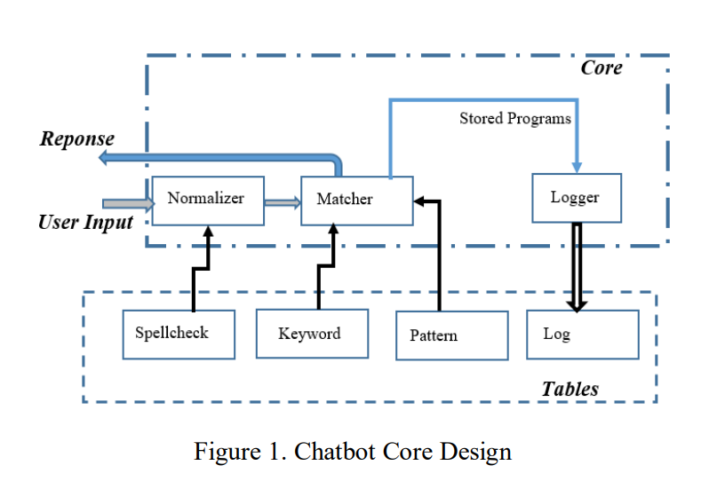
Methodology used

Slide 10
Methodology used
Figure 2 illustrates the classification of the chatbot framework with respect to responses and conversations. Retrieval based chatbot is employed in many of the academic web portal. Most of the FAQ loaded in in data base. Education institutions maintain the securable data whenever they prefer chatbot .Common guideline and information is shared in the beginning of the chat. Reponses delivered to user based on their log in credentials. Following information asked to verify the user info and security purpose (Student ID/Register Number, College Email, Registered mobile number, etc.)

Slide 11
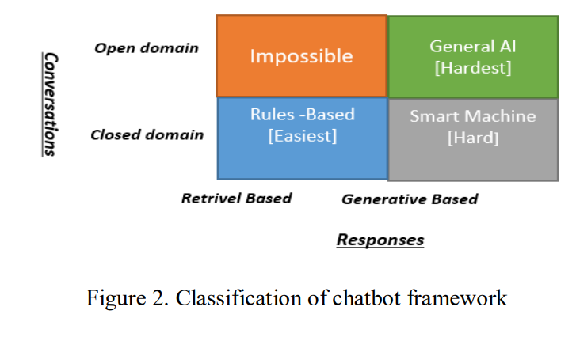
Methodology used

Slide 12
Methodology used
chatbots are a remedy. They are extremely convenient and simple to use, with the goal of providing automated responses to frequently asked questions while avoiding uncertainty and delayed responses. Retrieval-based chatbots (Figure 3) operate on the graph or directed flow principle.
The chatbot is programmed to provide the best response possible from a database of predefined responses. To determine the most appropriate response, retrieval-based chatbots employ techniques such as key phrase matching, machine based learning, or deep learning.

Slide 13
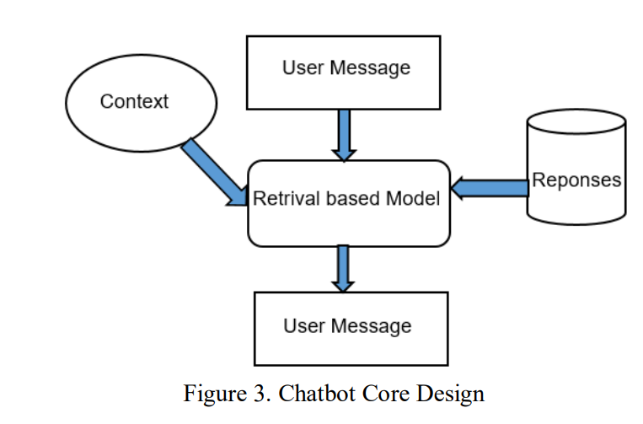
Methodology used
To determine the most apt response, on retrieval-based chatbots employ techniques such as keyword synonym, machine based learning, or deep learning algorithms. Whatever technique is used, these chatbots only provide preset responses and do not create new output.

Slide 14
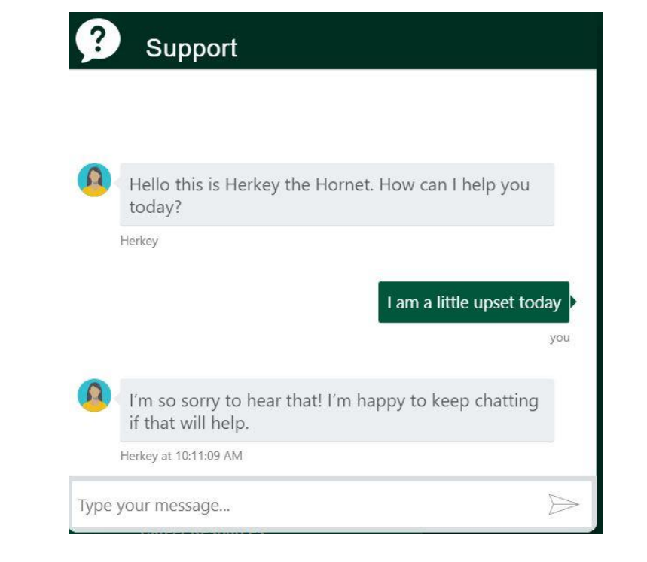
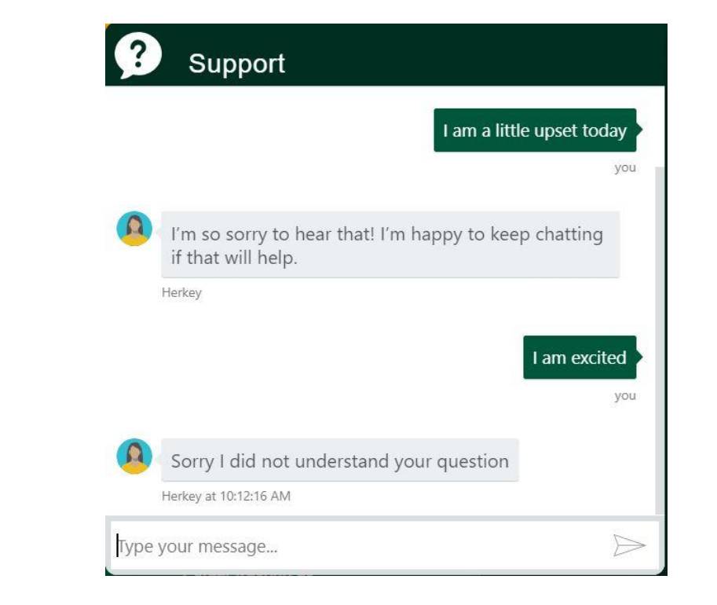
Results and Outputs
Bot successfully detecting the sentiment of the query
Bot failed to detect the sentiment of the query

Slide 15
Conclusion
To conclude, College Enquiry Chatbot is helpful in guiding students with correct and most up to date sources of information. It is advantageous for international applicants for queries such as fee payment and academic matters. Students can get the information at their fingertips rather than visiting college office.
It improves efficiency by taking over tasks for which humans are not essential. Sentiment analysis implemented in College Enquiry Chatbot correctly recognizes the user’s query such as positive, negative, and neutral by storing all the conversations in the database.
However, the system was partially successful in adding empathy since scope of these queries is vast and the system requires more rigorous data to handle all the questions which are out of script. Nevertheless, active learning helps to improve the bot performance for handling off-script queries.

Slide 16
Future Scope
To improve the current functionalities of College Enquiry Chatbot, in the future, the scope of the chatbot can be increased by inserting data for all the departments, training the bot with varied data, testing it on live website, and based on that feedback inserting more training data to the bot. Some of the new features which can be added to the bot are
1) speech recognition feature through which students can ask their queries verbally and get the answers from the bot,
2) integration with multiple channels such as phone call, SMS, and various social media platforms like Skype, Facebook and Twitter,
3) handling context aware and interactive queries in which bot will be aware of the context of an ongoing conversation with a student,
4) integration with services such as password reset and course 46 enrollment, and 5) adding a capability for the bot to perform analytics based on user’s sentiment based on which the bot can be re-trained on human emotions so that more empathy can be added to the bot

Slide 17
References
W. Astuti, D. P. I. Putri, A. P. Wibawa, Y. Salim, Purnawansyah and A. Ghosh, "Predicting Frequently Asked Questions (FAQs) on the COVID-19 Chatbot using the DIET Classifier," 2021 3rd East Indonesia Conference on Computer and Information Technology (EIConCIT), 2021, pp. 25-29.
International Research Journal of Modernization in Engineering Technology and Science ( Peer-Reviewed, Open Access, Fully Refereed International Journal ) Volume:04/Issue:11/November-2022 Impact Factor- 6.752

